Slide 1
Precision Oncology: The future of cancer therapy.
By:
Nader Javadi MD
GM-Javadi Precision Medicine, LLC

Slide 3
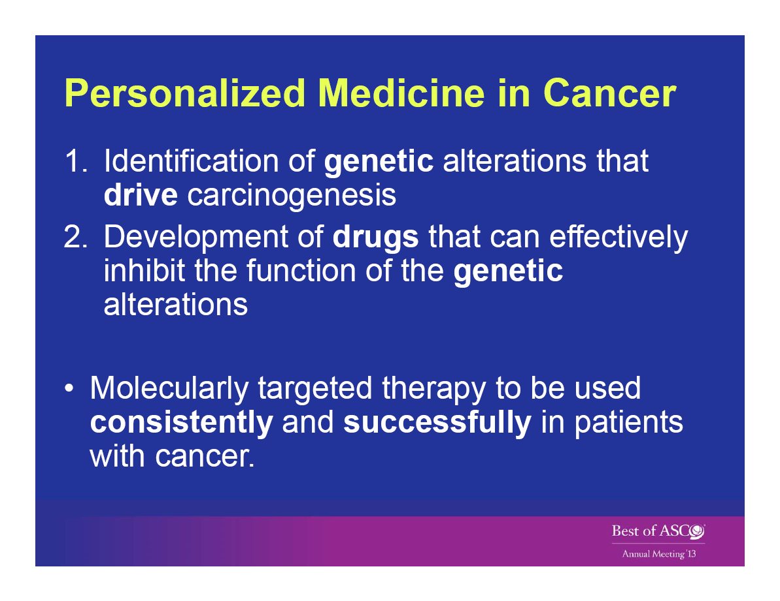

Slide 4
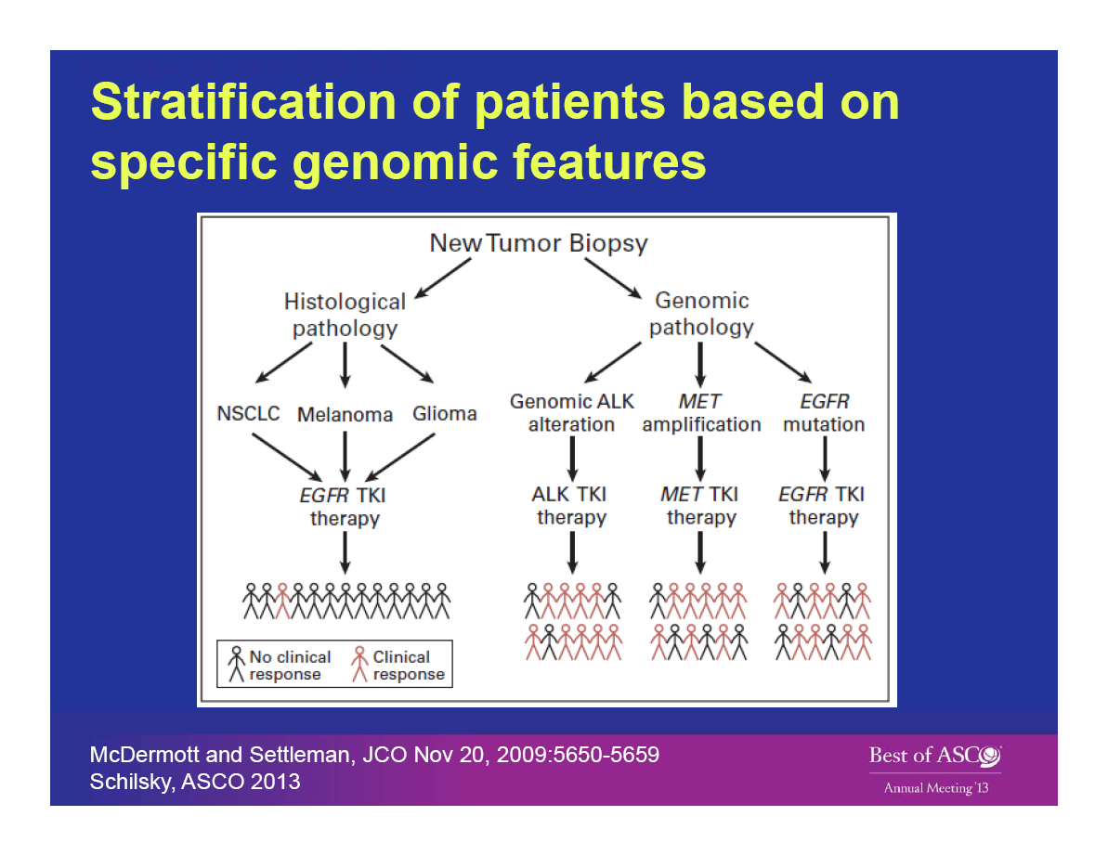

Slide 5
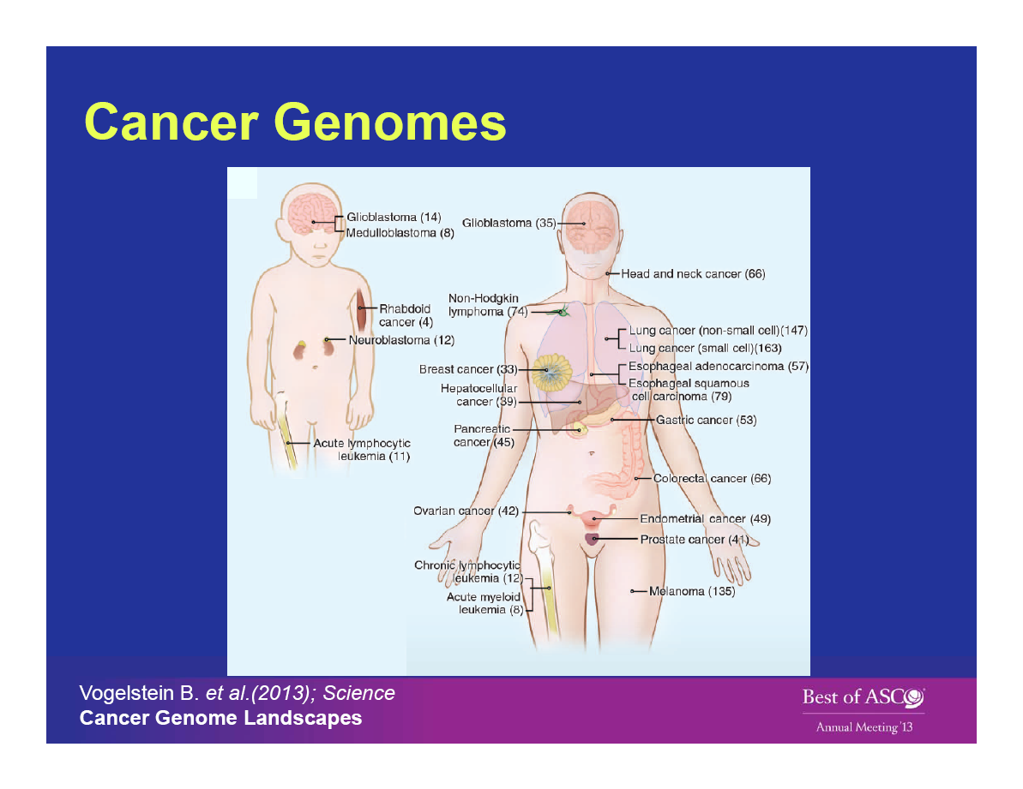

Slide 6
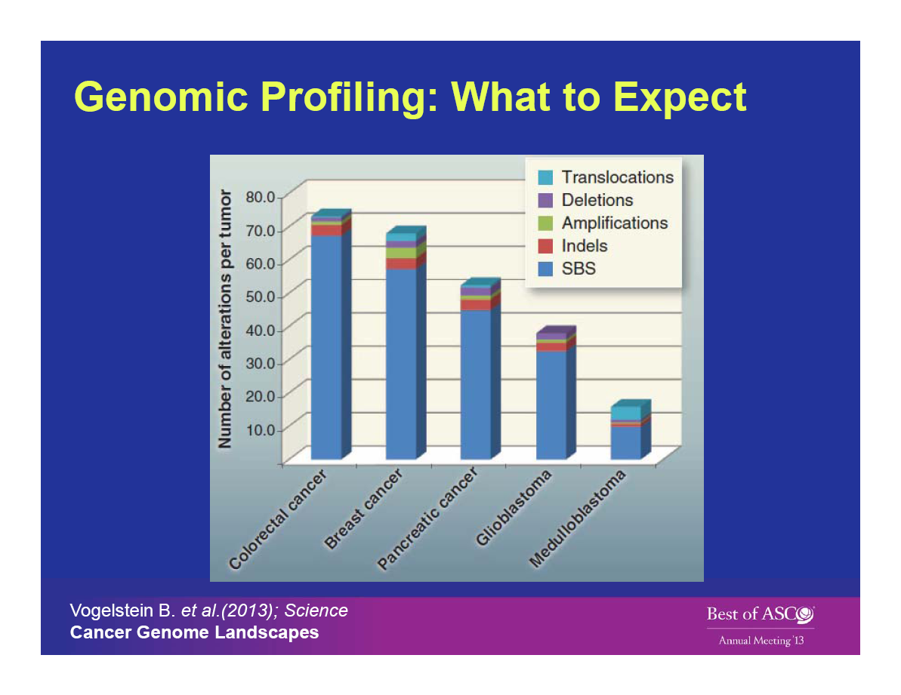

Slide 7
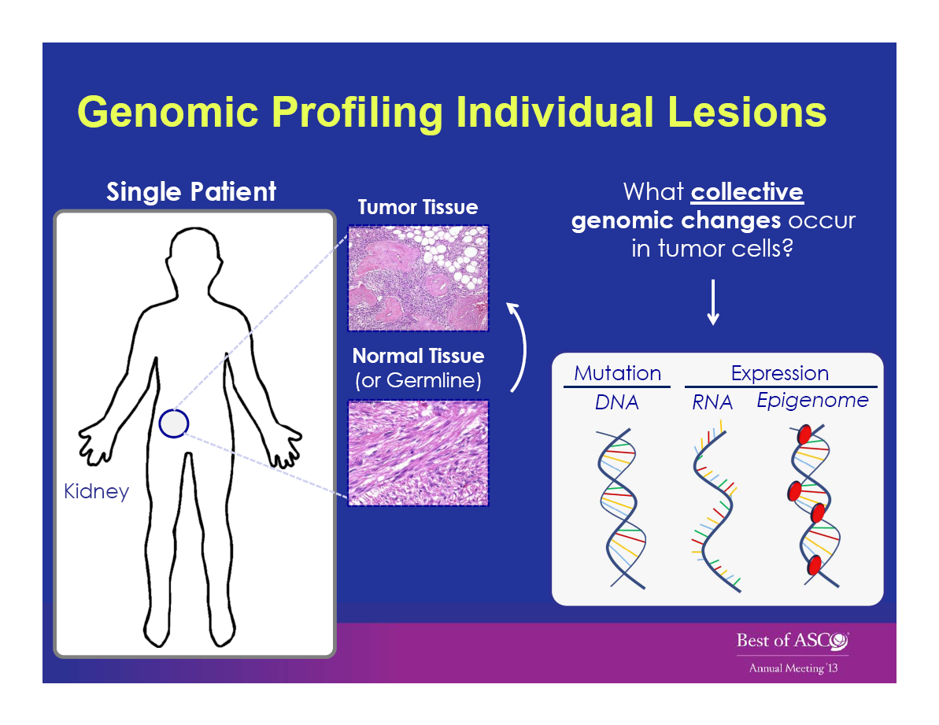

Slide 8
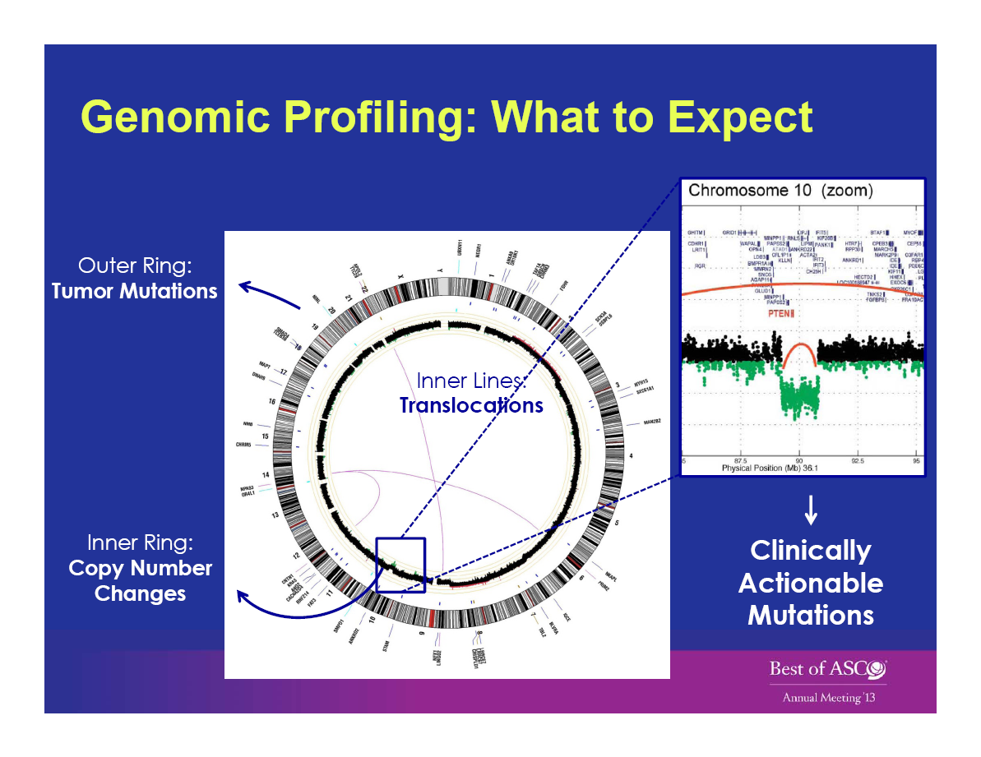

Slide 9
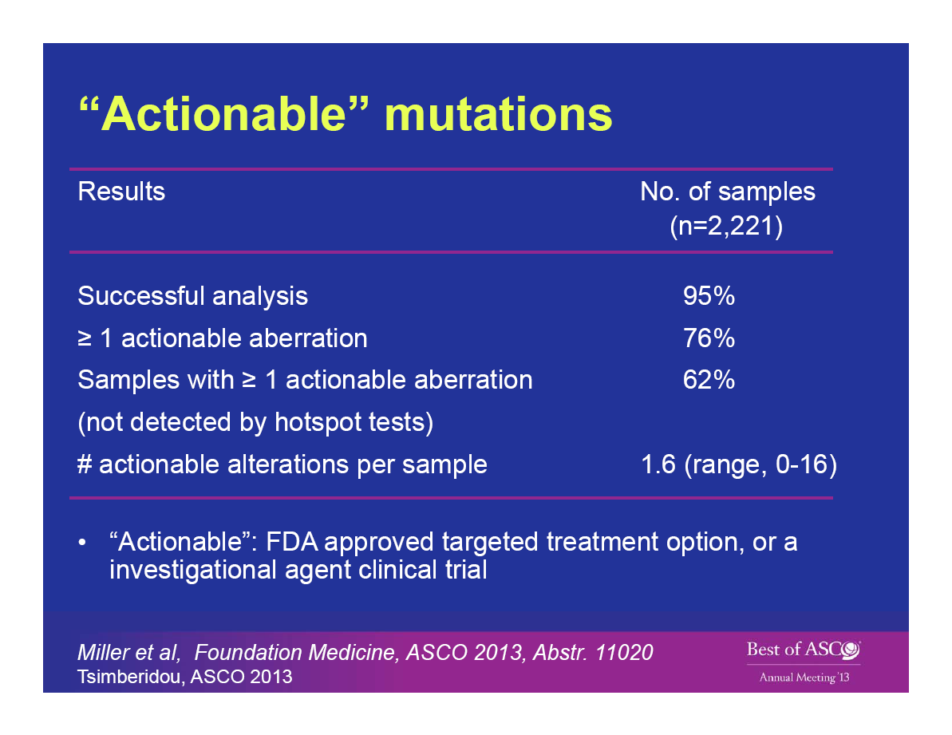

Slide 10
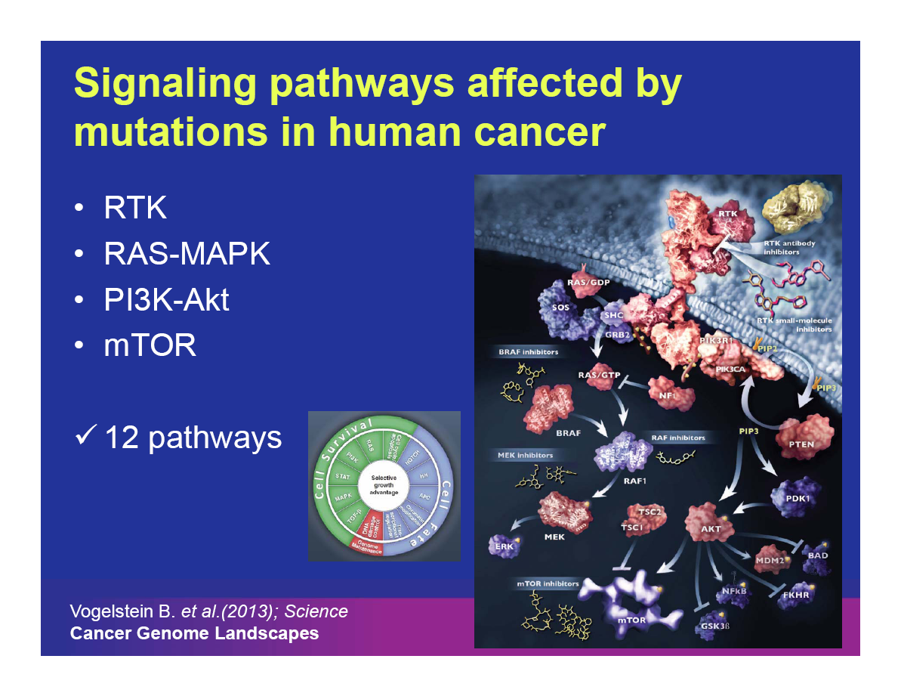

Slide 11
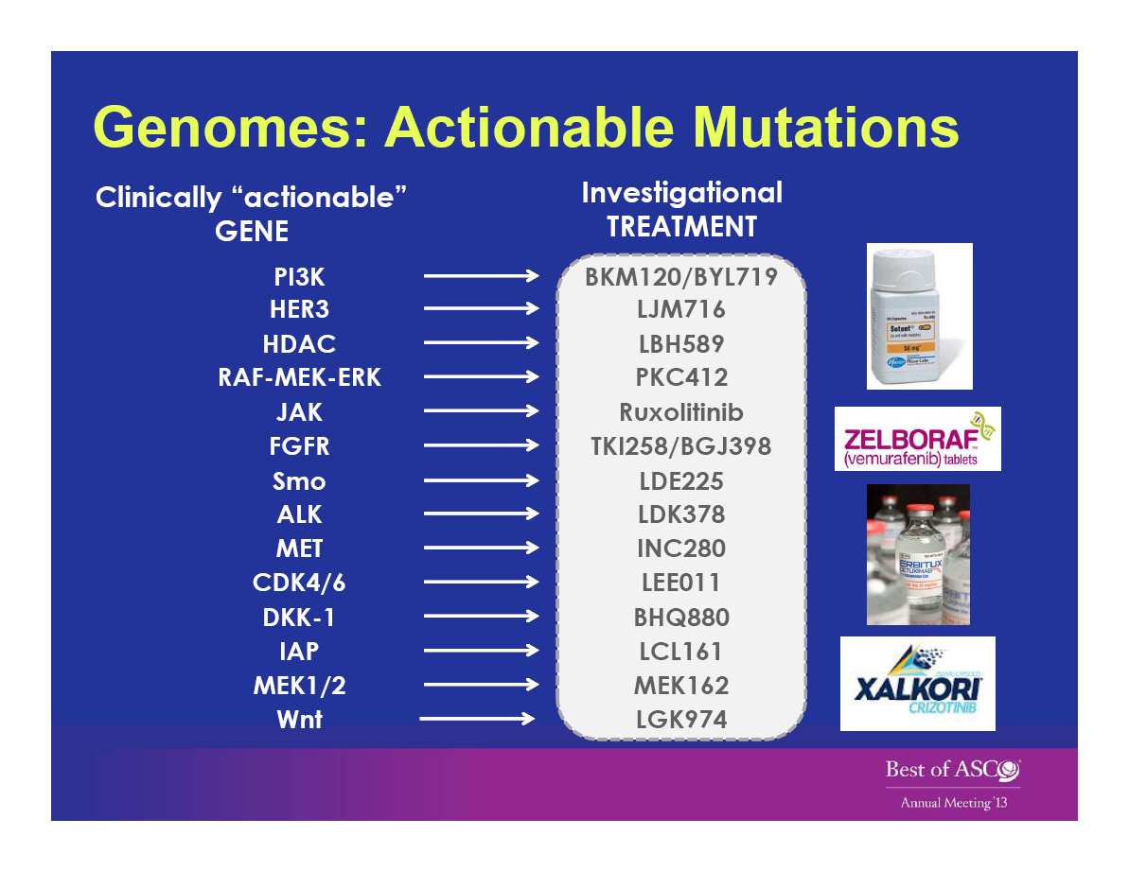

Slide 12
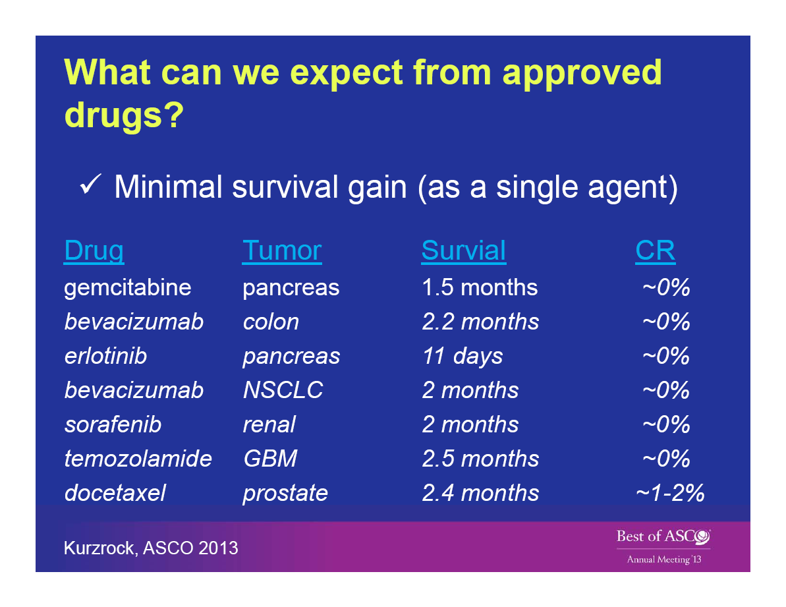

Slide 13
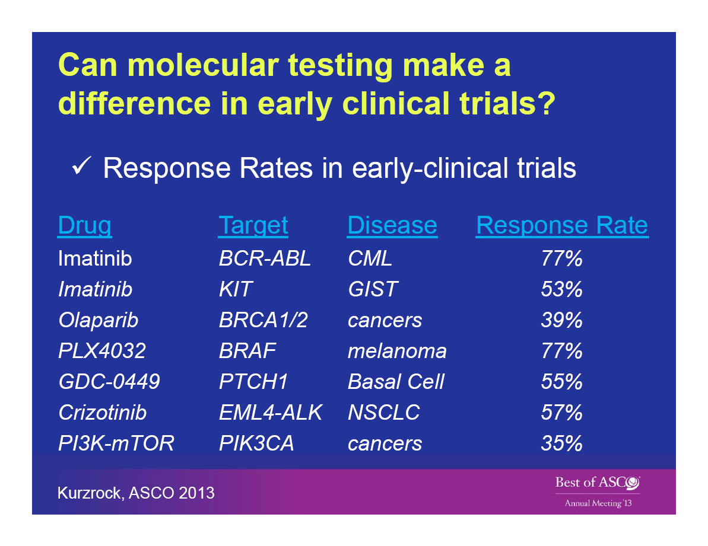

Slide 14
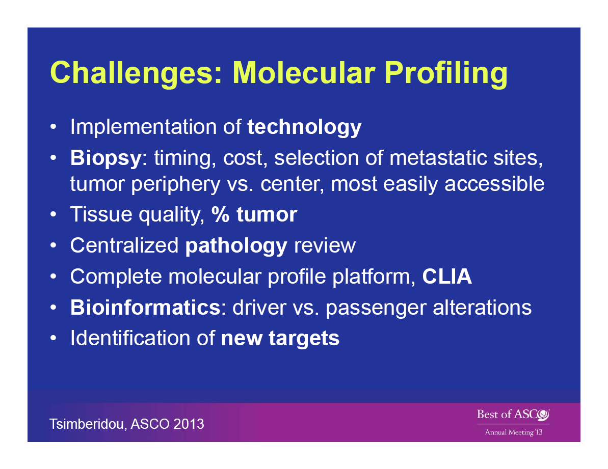

Slide 15
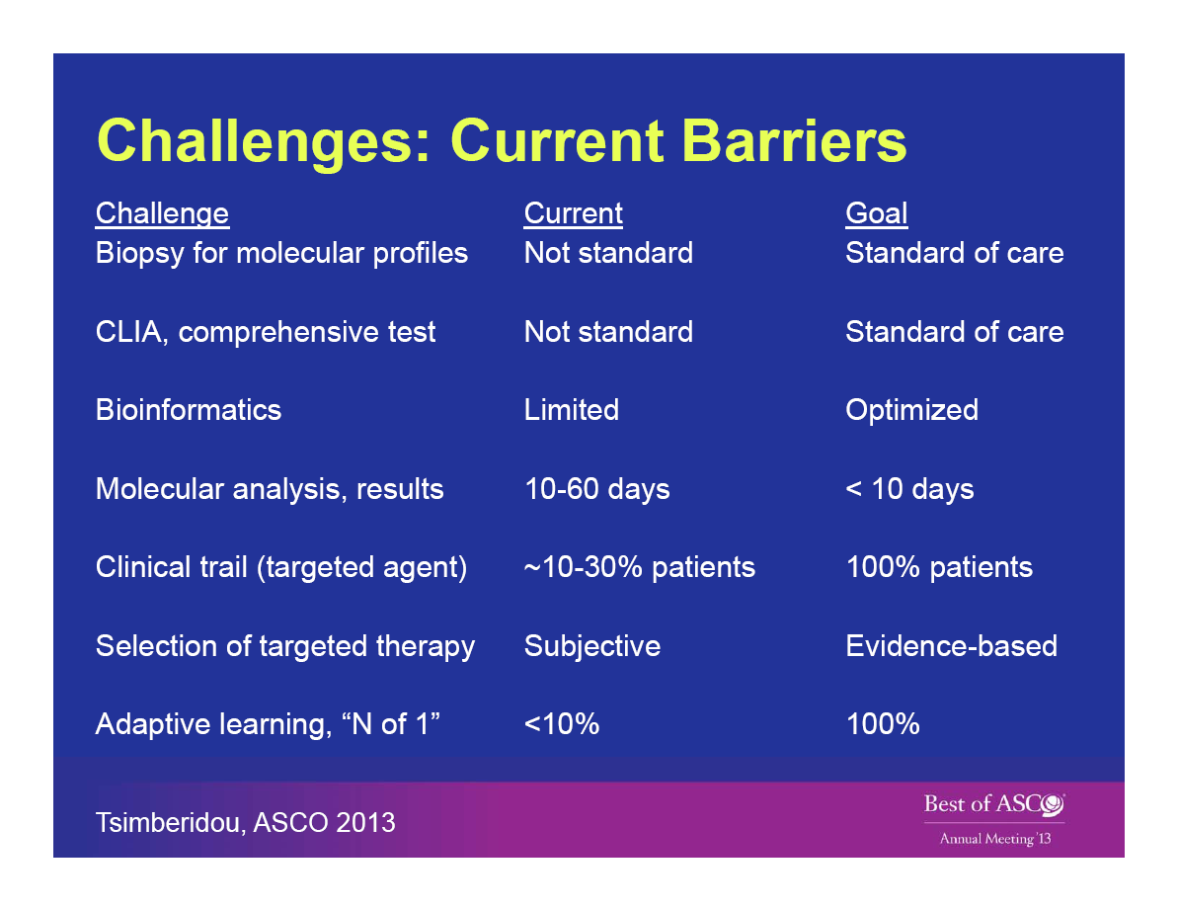

Slide 16
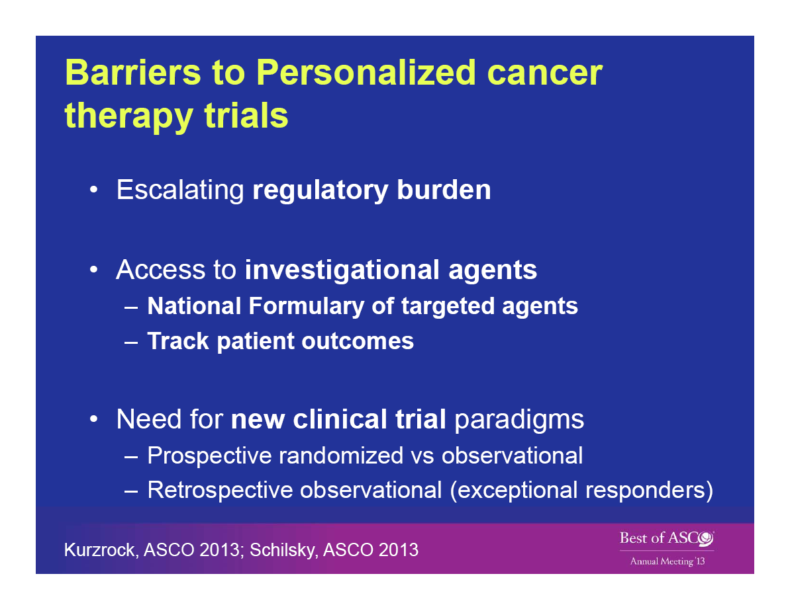

Slide 17
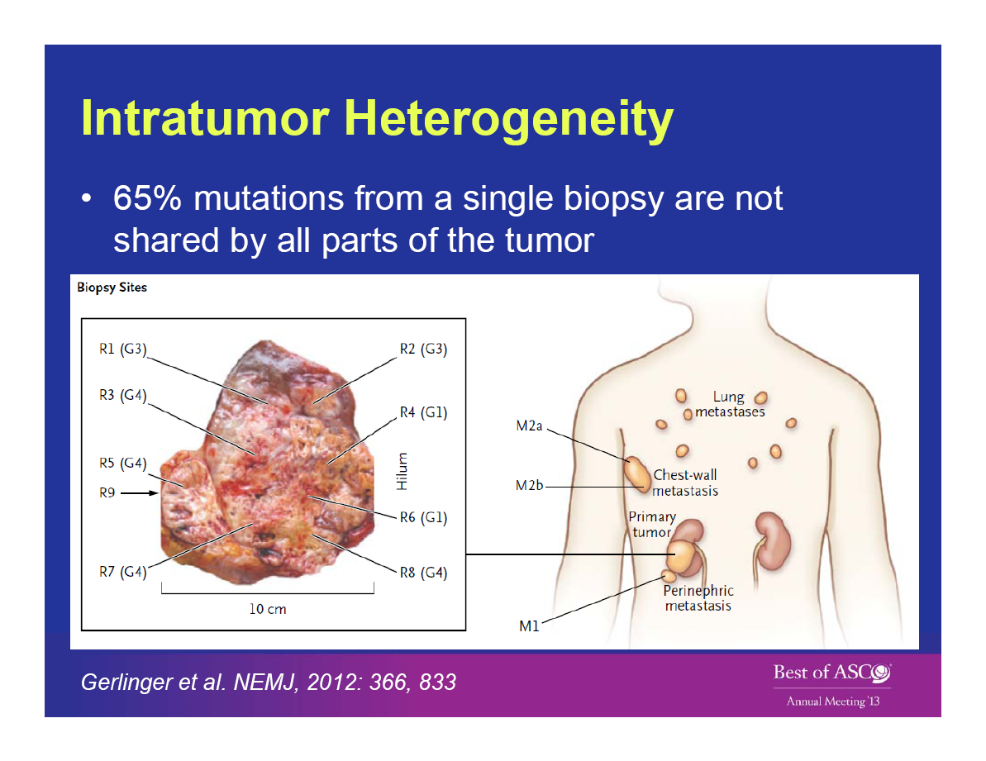

Slide 18
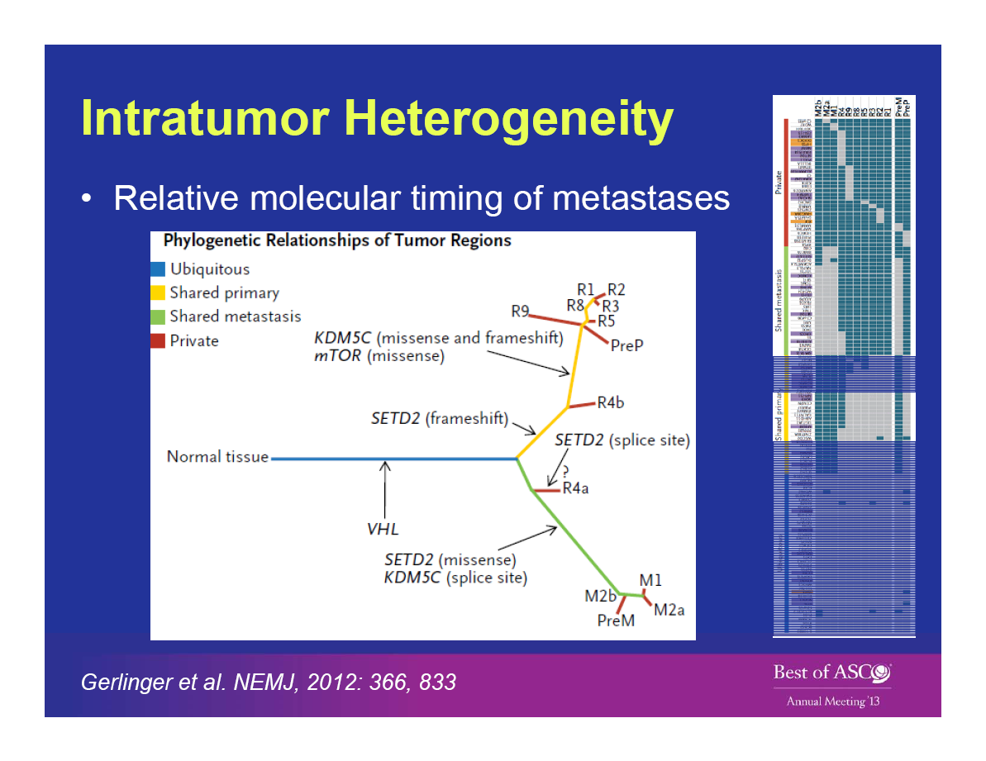

Slide 19
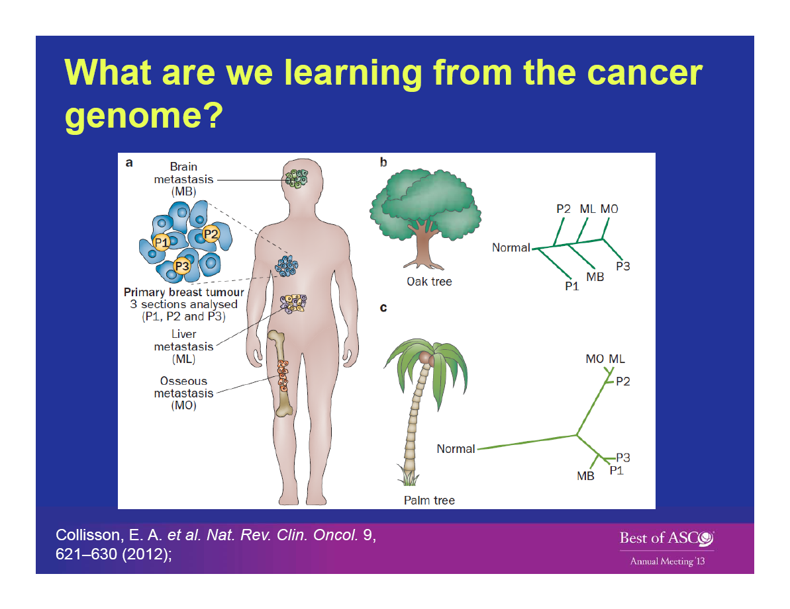

Slide 20
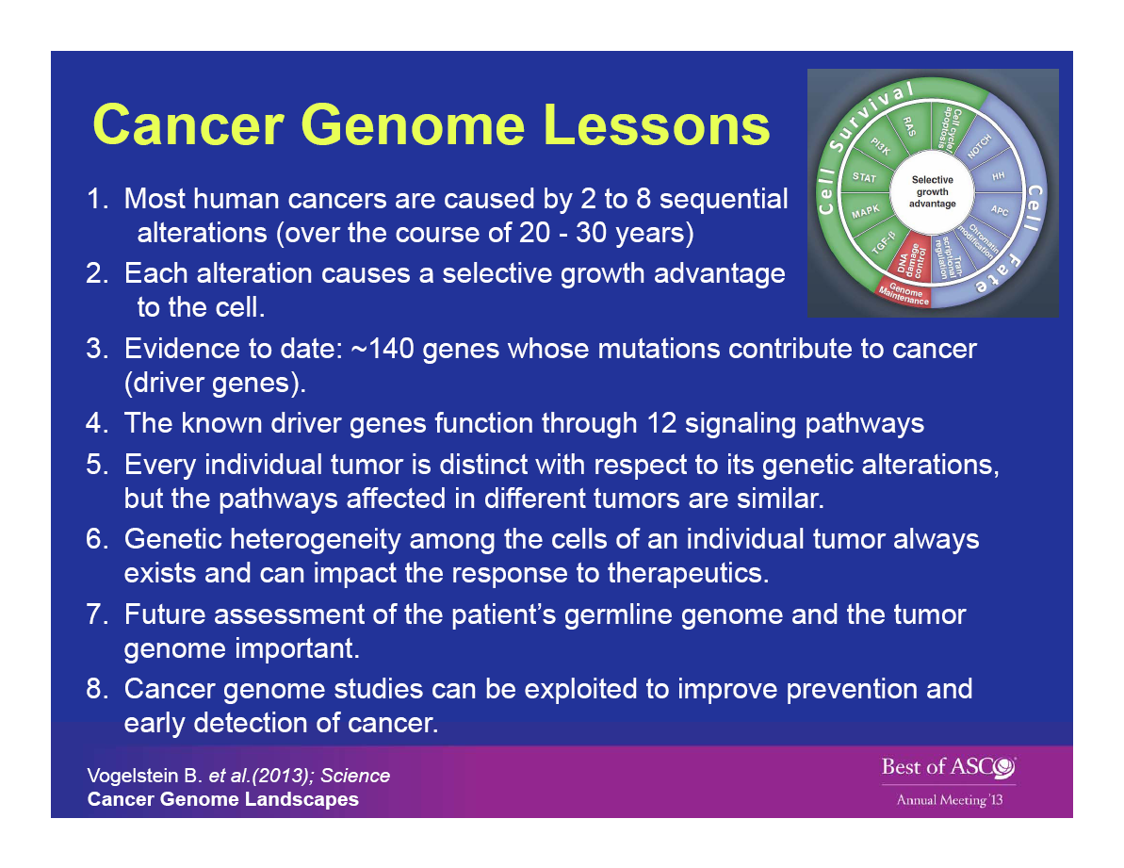

Slide 21
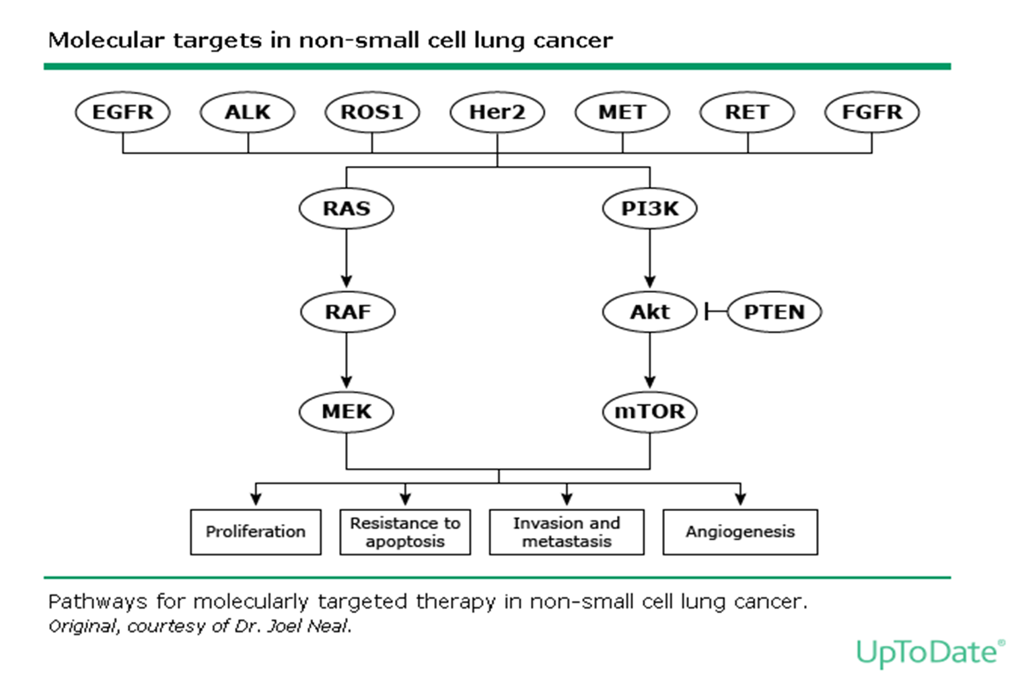

Slide 22
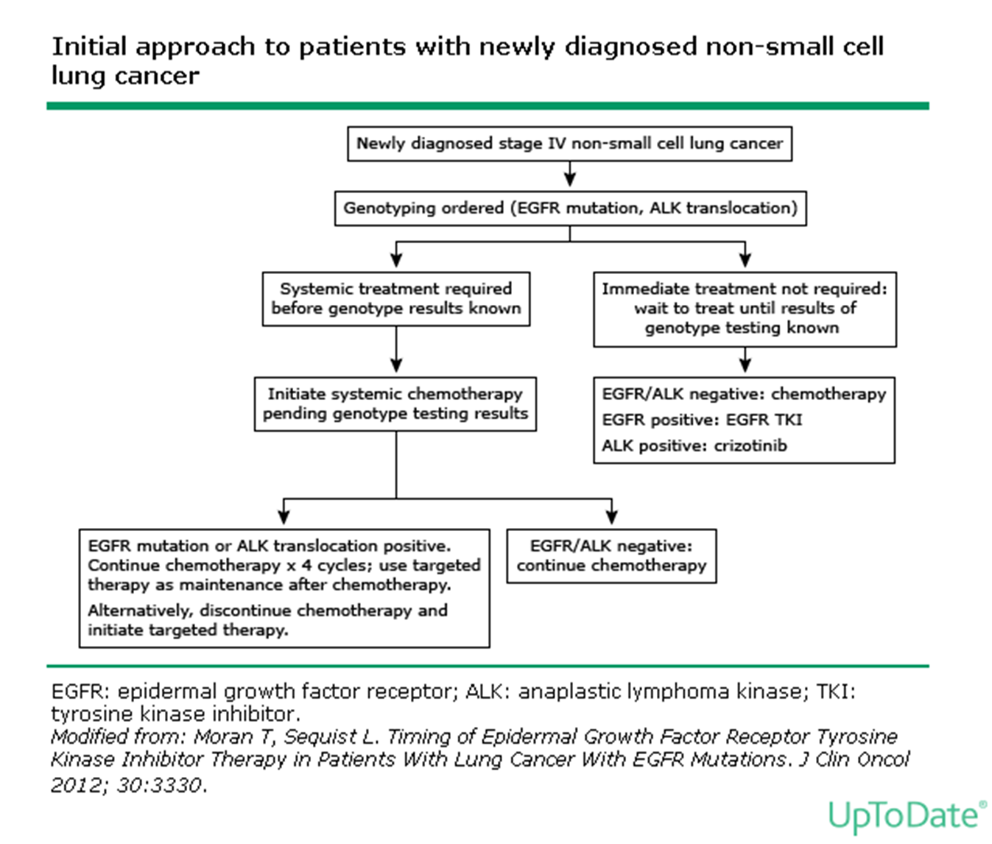

Slide 23
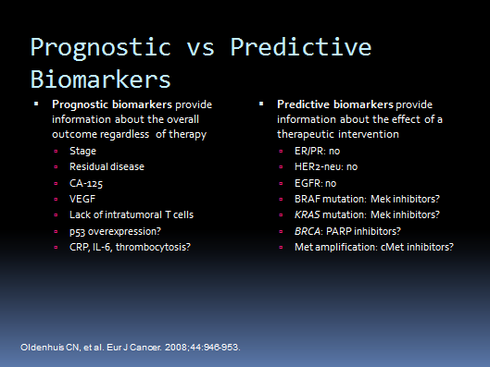

Slide 24
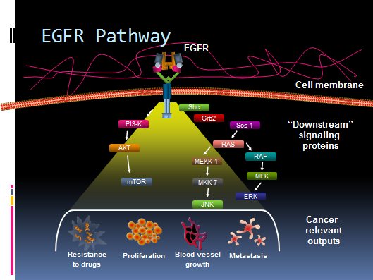

Slide 25
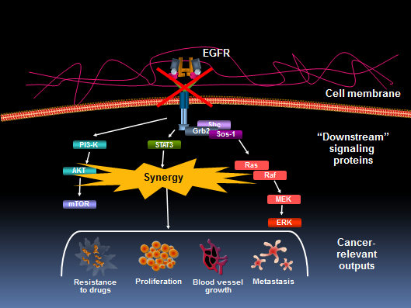

Slide 26
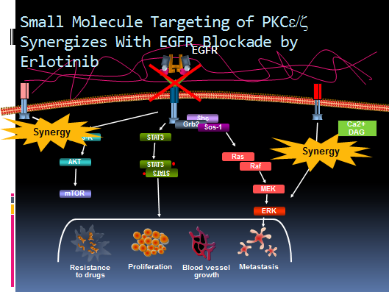

Slide 27
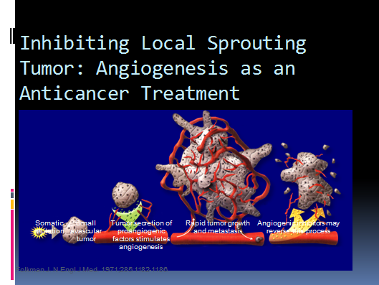

Slide 28
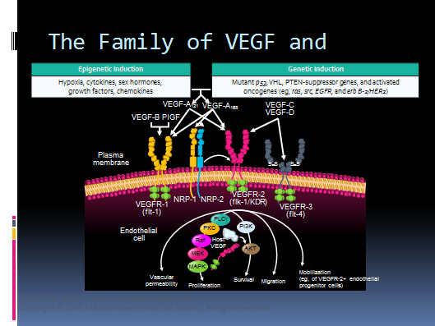

Slide 29
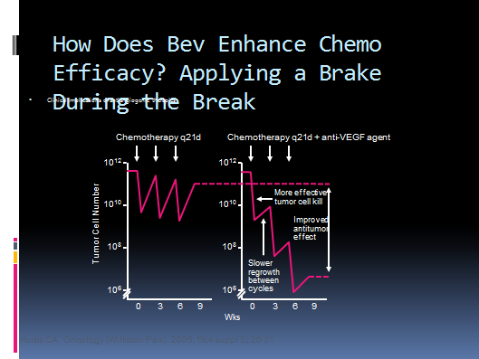

Slide 30
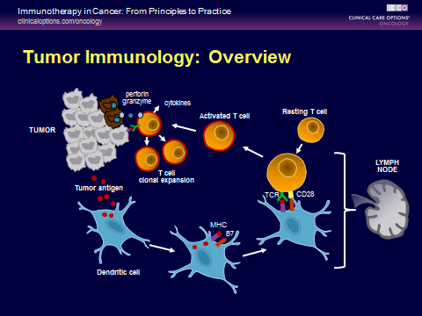

Slide 31
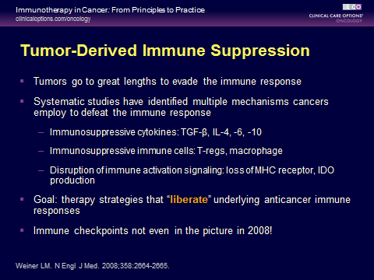

Slide 32
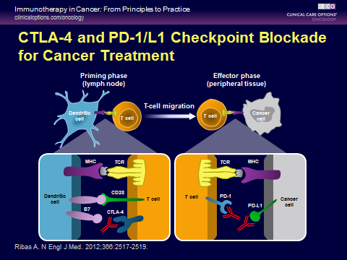

Slide 33
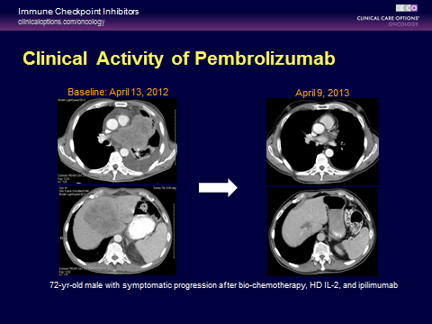

Slide 34

Is Receipt of Chemotherapy Prior to Immunotherapy Important Biologically?
Potential immunogenic effects of chemotherapy
Release of tumor antigens
Translocate CRT to surface of tumor cell, an “eat me” signal to DCs → phagocytosis
Cause secretion of ATP “find me” signal to DCs
Release dsRNA → autonomous secretion of type I interferons “revving” the immune response
Deplete regulatory T cells and/or myeloid-derived suppressor cells
Emens LA, et al. Cancer Immunol Res 2015;3:436-443.
Slide credit: clinicaloptions.com
Notes:
ATP, adenosine triphosphate; CRT, calreticulin; CRTR, calreticulin receptor; DC, dendritic cells; dsRNA, double-stranded RNA.

Slide 35
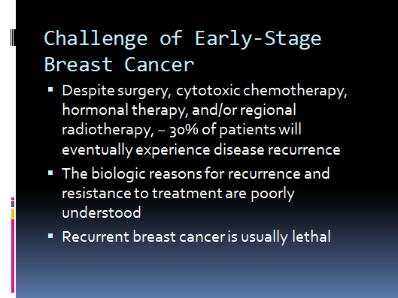

Slide 36
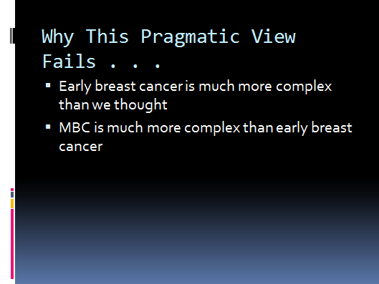

Slide 37
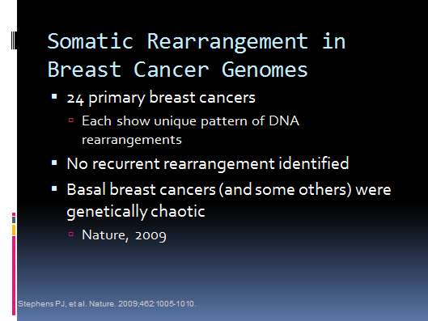

Slide 38
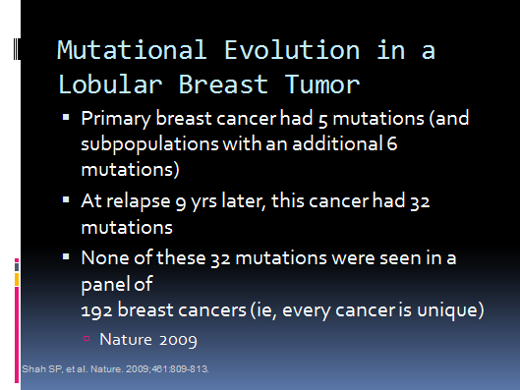

Slide 39
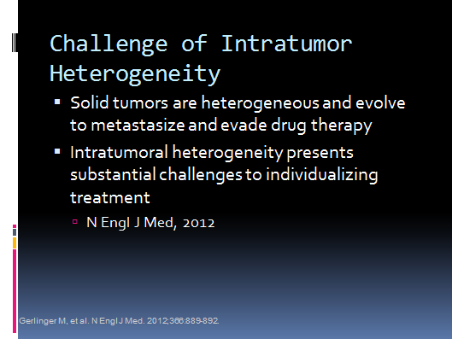

Slide 40
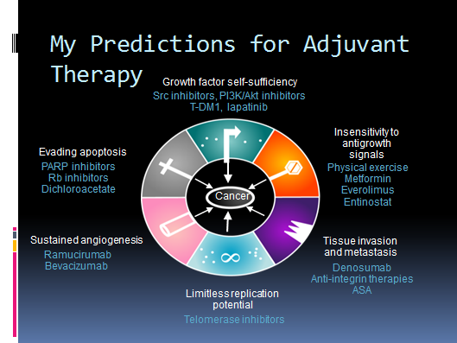

Slide 41
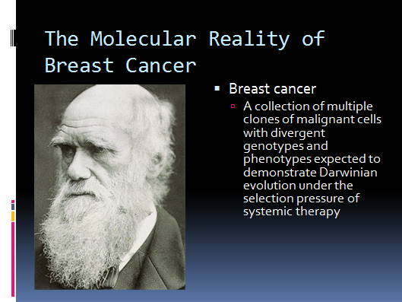

Slide 42
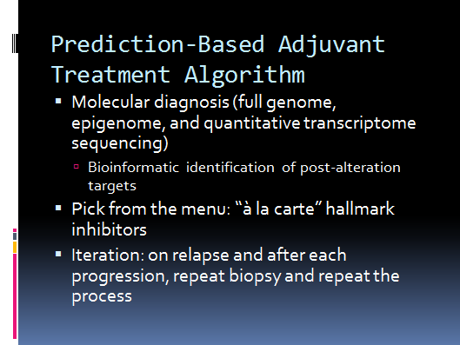

Slide 43
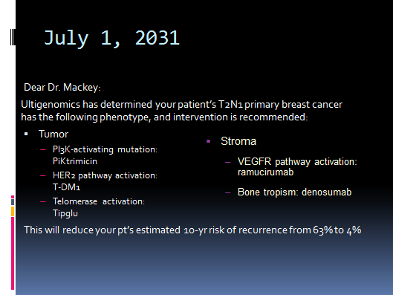

Slide 44
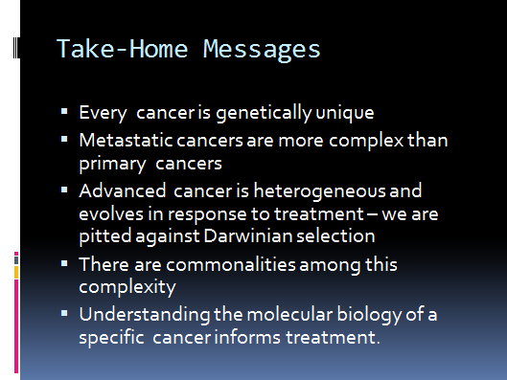

Slide 45
Precision oncology objectives:
Involving multi-pathway targeted therapy along with other therapeutics including immunotherapy beside chemotherapy tailored to each patient’s tumor genetics and chemosensitivity.
Try to obtain a higher and more durable response.
Obtain a better quality of life and avoid unnecessary toxicity.
Ultimately improving overall survival and changing a deadly progressive disease to a chronic one.

Slide 46
Precision oncology rational:
Many randomized clinical trials in advanced cancers have shown that combination chemotherapies or targeted therapies provide superior response rates and survival compared to a single therapy.
Careful selection of different therapeutics with different mechanisms of action may provide synergism.
Additional toxicities with combination therapy can be avoided with dose adjustment based on pharmacokinetic and pharmacodynamic studies.
“One size fit all” approach doesn’t work anymore!

Slide 47
Precision oncology tools:
Next generation gene sequencing
Liquid biopsy (circulating tumor DNA)
DNA/RNA Microarray studies
Specific tumor markers

Slide 48
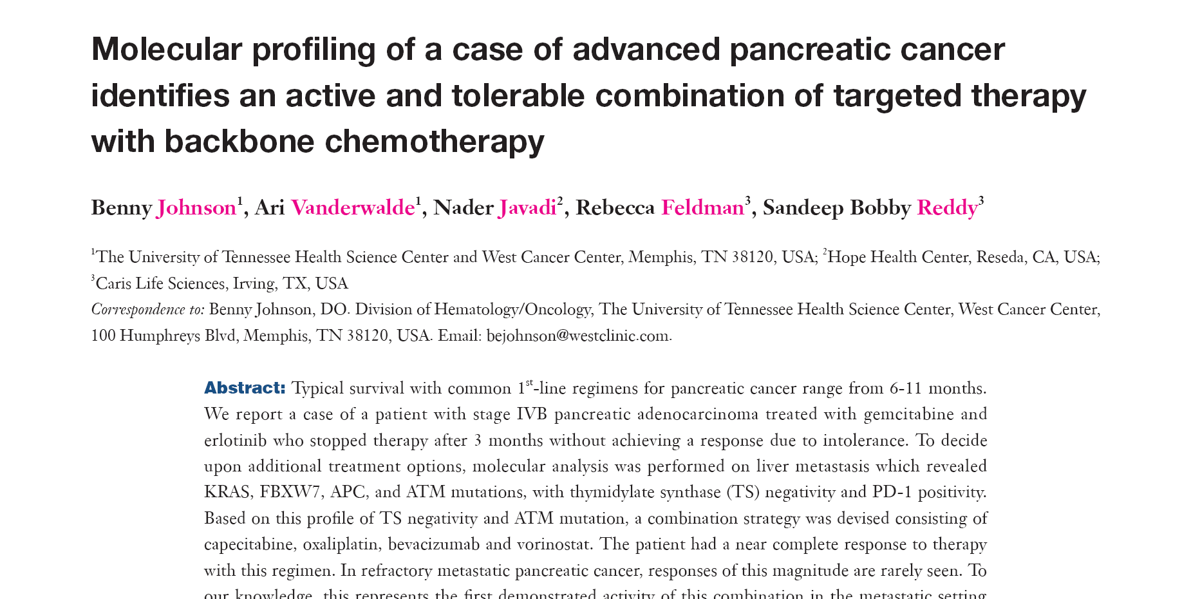
Patient case 1

Slide 49
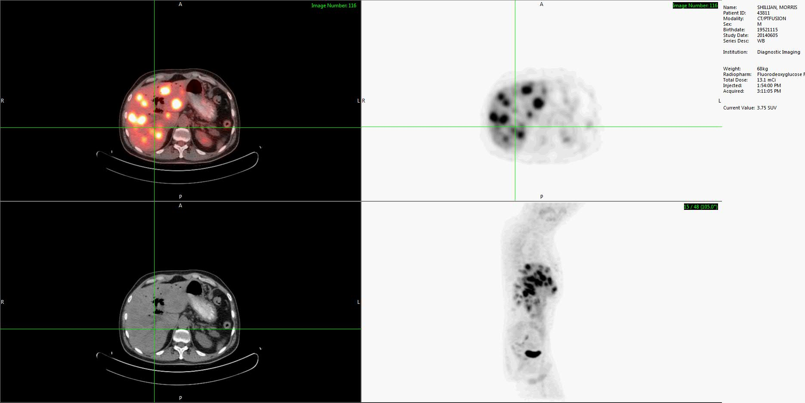

Slide 50
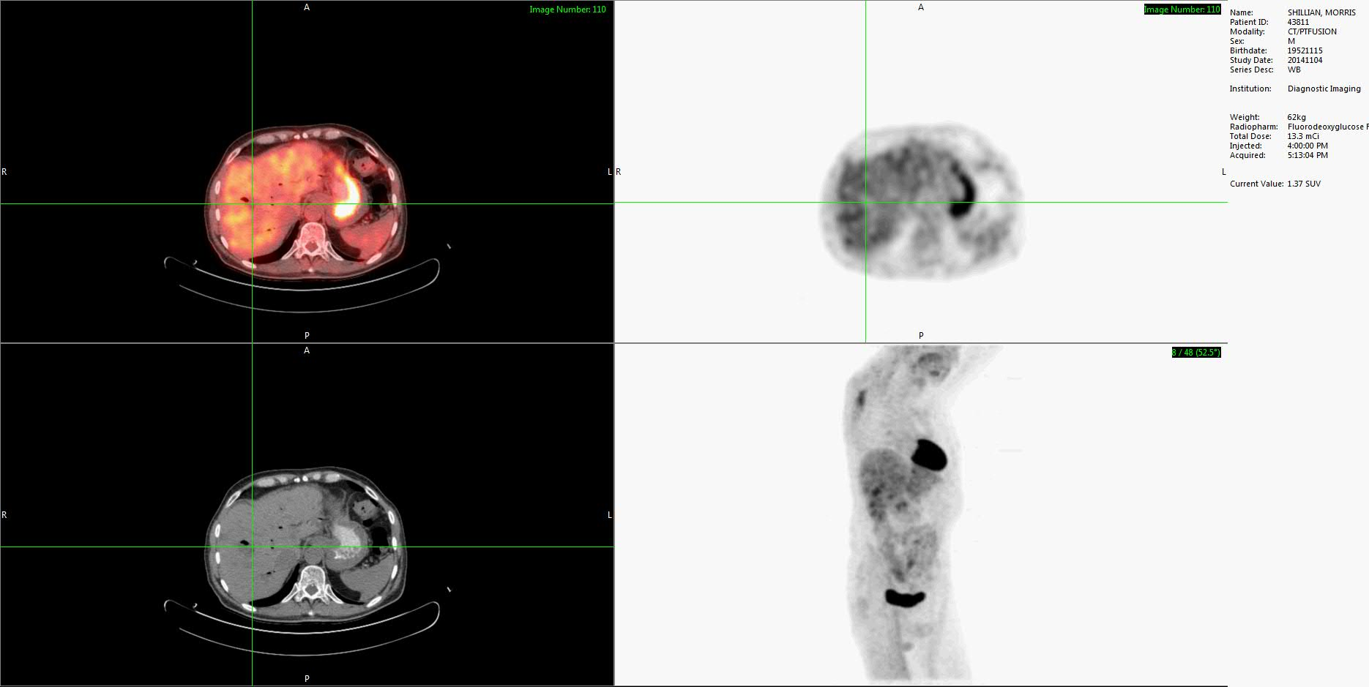

Slide 51
Patient case 2
EE was a 79 year old woman presented with locally advanced adenocarcinoma of unknown primary favored pancreatic. NGS showed TP53,FLT3 mutations and PDL1 overexpression on IHC, also sensitivity to irinotecan, adriamycin. She failed initial blind chemo using XELOX. She started on XELIRI+avastin+Opdivo(anti-PD1 immunotherapy).
She was c/o severe abdominal pain and weight loss which resolved after the first combination targeted therapy.

Slide 52
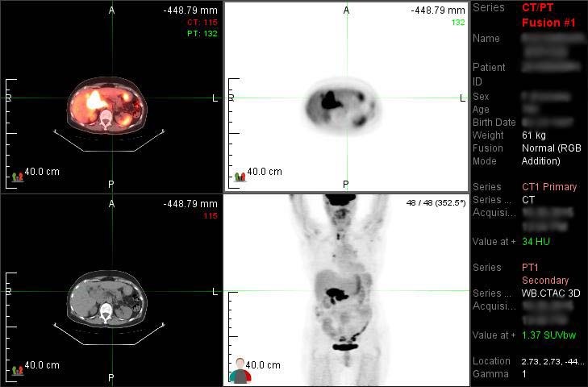

Slide 53
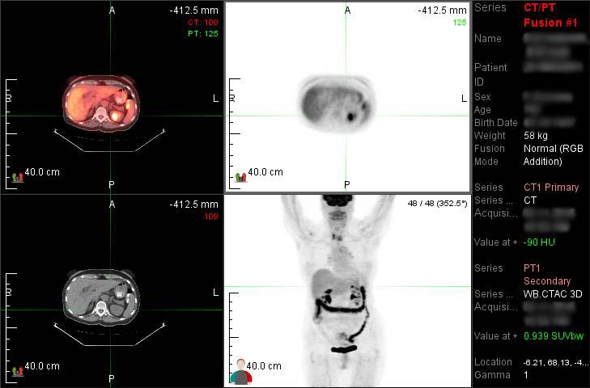

Slide 54
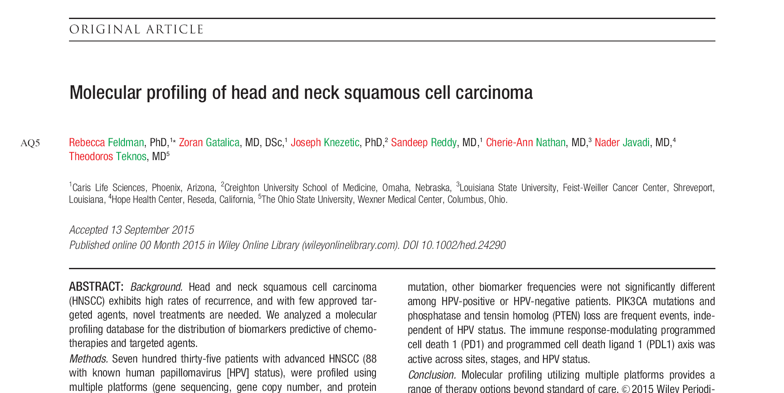
Patient case 3

Slide 55
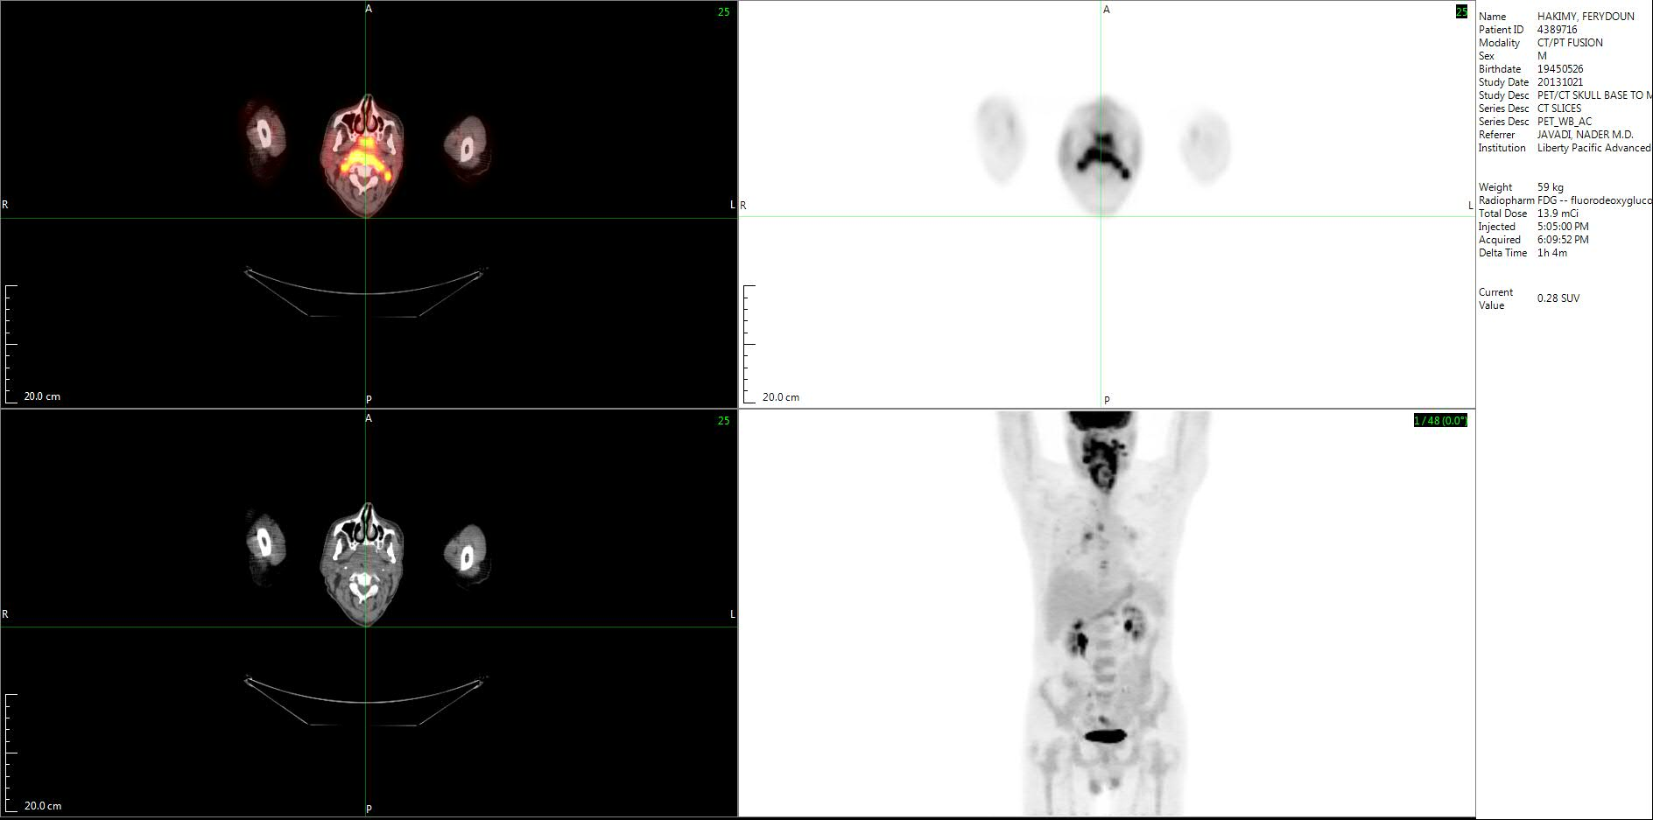

Slide 56
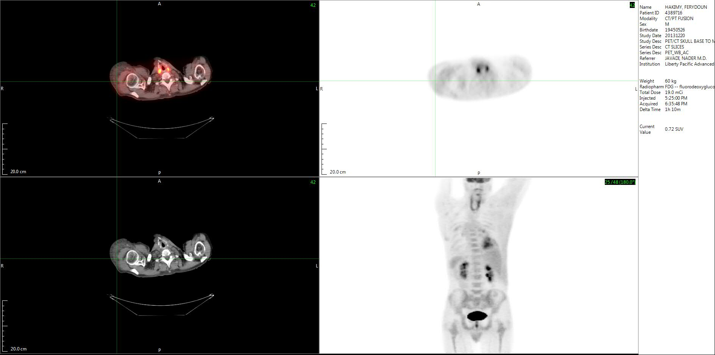

Slide 57
Patient case 4
58 y/o woman with history of stage IV ovarian cancer treated for 4 years failing 5th line of therapy sent to hospice by her oncologist. 40lbs weight loss, severe abdominal pain and ascites with palpable nodular metastasis on abdominal wall.
After initial NGS and chemosensitivity tests she was started on a unique combination protocol used for the first time in the world using 3 medications(abraxane,alimta,avastin) with synergistic effect.

Slide 58
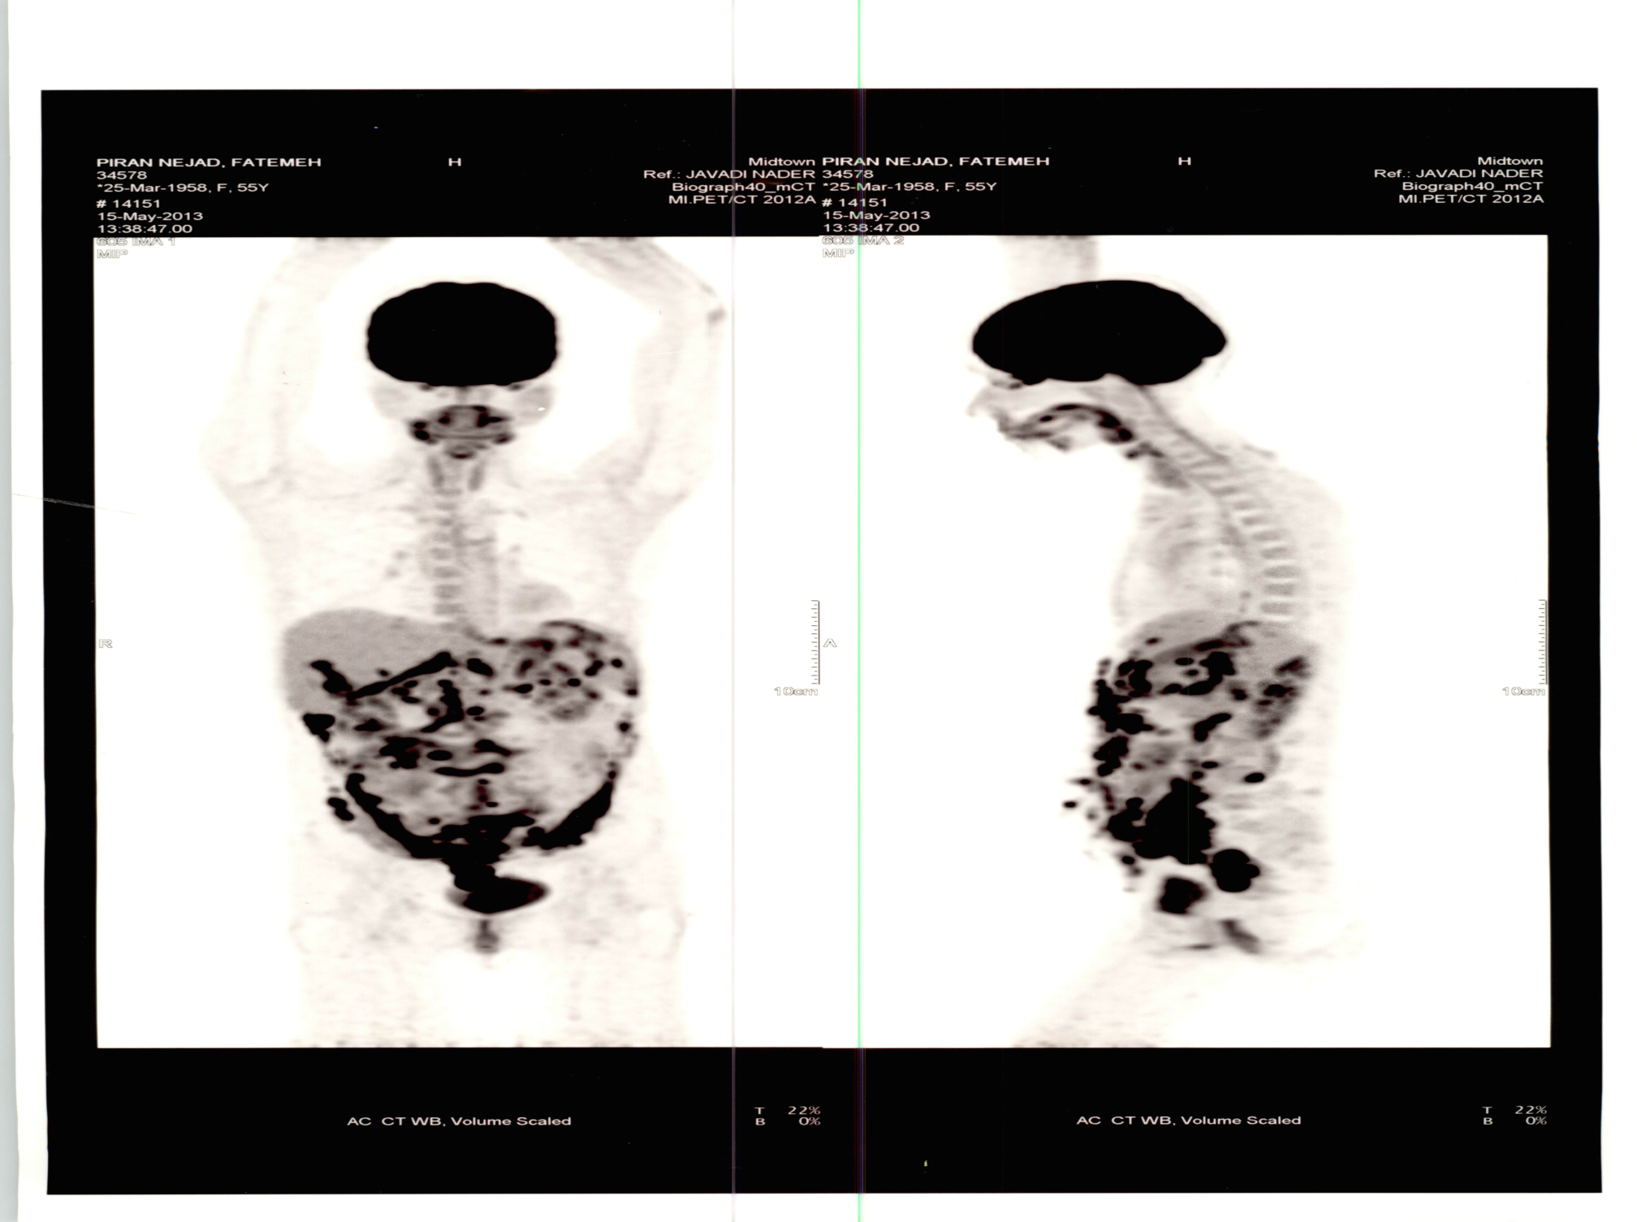

Slide 59


Slide 60
Patient case 5
72 y/o man presented with abdominal pain and weight loss and dyspnea. CT-CAP showed a large abdominal mass attached to right kidney with multiple abdominal LAP, also a large right lung mass. Initial biopsy showed poorly differentiated carcinoma favored soft tissue sarcoma. He received a chemo protocol using adriamycin and ifosfamide with progressive disease.
Tissue sent for NGS and chemosensitivity test revealing a primary kidney cancer more likely.
He started on Torisel,avastin,thalidomide.

Slide 61


Slide 62


Slide 63
Thank you!

