Slide 1
Definition of kidney disease
Any process that can cause kidney damage and decrease the function
GFR less than 60ml/min/1.73m2
Its characterized by albuminuria, hematuria, accumulation of urea, electrolyte abnormality, anemia, with or without decrease in urine output
Its considered chronic if damage is progressive, irreversible and lasts more than 3 months
26 million Americans have different stages of CKD
more than 250,000 people receive dialysis yearly

Slide 2
Etiology of CKD
Diabetes 37%
Hypertension 30%
Chronic glomerulonephritis 12%
Polycystic kidney disease
Interstitial nephritis
Obstructive disease
Vascular and autoimmune diseases

Slide 3
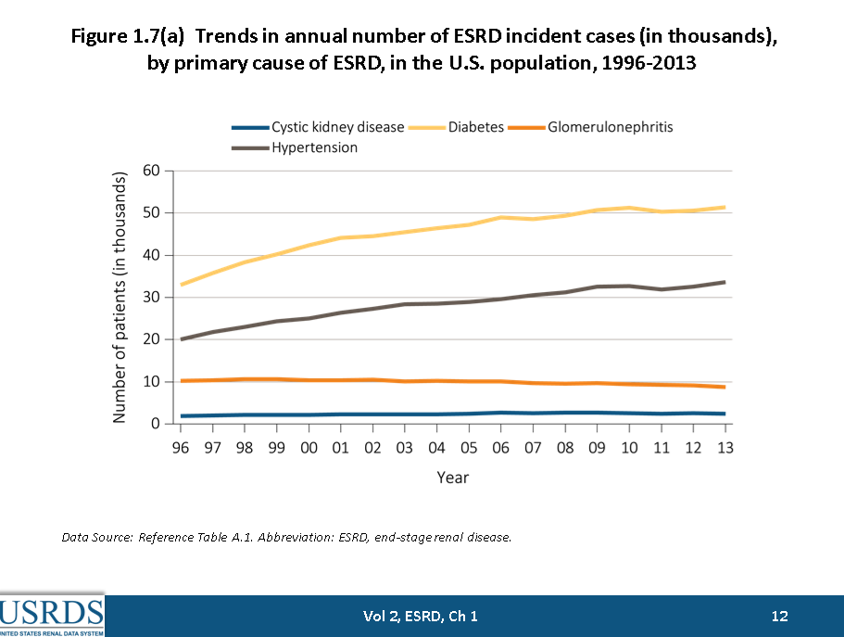
Evaluation of kidney TX candidates

Slide 4
Stages of CKD& RRT
Stage I : normal GFR with microalbuminuria
Stage II : GFR 89 to 60 ml/min
Stage III : GFR 59 to 30 ml/min
Stage IV : GFR 29 to 15 ml/min
Stage V : GFR < 15ml/min, or ESRD
Patients in stage I to IV will need medical management
Patients with ESRD will need renal replacement therapy
( peritoneal dialysis /hemodialysis) or kidney transplant

Slide 5
Kidney transplantation
Over the last 30 years more than 500,000 organ transplant performed in United States
50% of cases were kidney transplant
In 2015, 17,878 kidney transplant performed
17% of dialysis patients are listed for transplant
9% of dialysis patients getting transplant

Slide 6
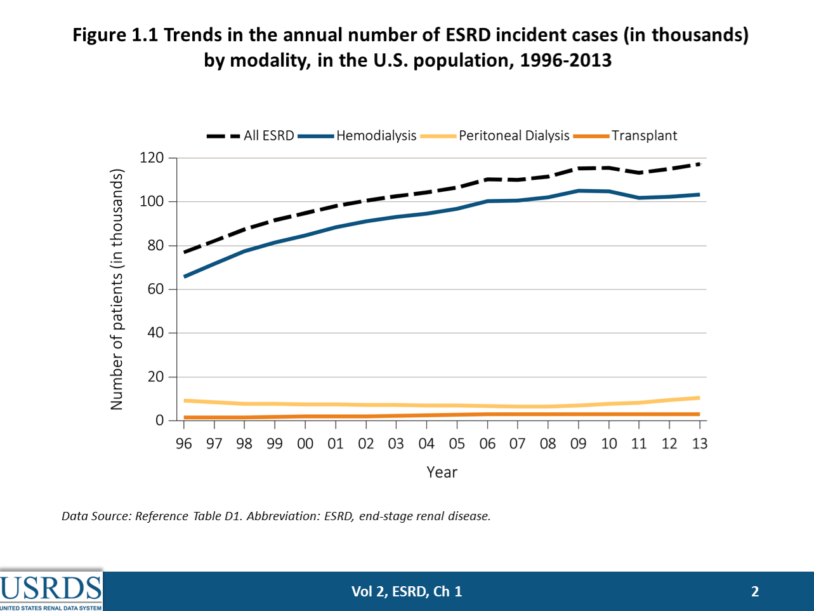
Evaluation of kidney transplant

Slide 7
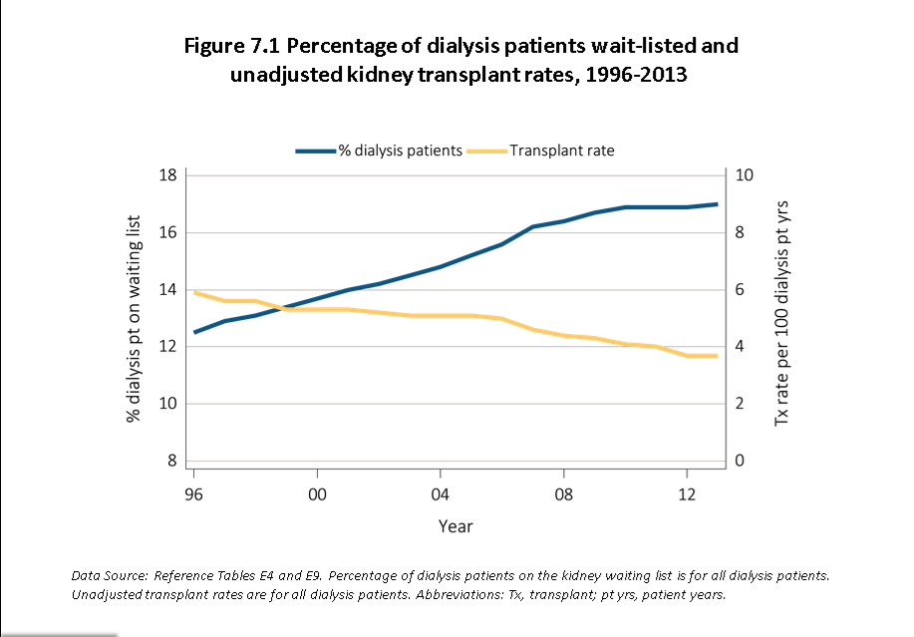
Evaluation of kidney TX candidates

Slide 8
ESRD Survival by Treatment Modality
National Kidney Foundation. Available at: http://www.kidney.org.
Notes:
Transplantation carries a significant survival advantage over dialysis, and the advantage becomes greater over time. This chart may slightly overstate the survival advantage for transplantation, since the dialysis population contains a number of patients with risk factors that disqualify them from placement on the transplant waiting list. Still, transplantation significantly reduces the risk of death, even for dialysis patients on the transplant waiting list.
National Kidney Foundation. Available at: http://www.kidney.org.

Slide 9
Evaluation of TX candidates
Identify patients with lowest risk of morbidity & mortality, and highest quality of life,
Refer patients when GFR is close to 25ml/min
Frequent re assessment of older candidates
Infection evaluation(HIV,T.B, hepatitis, CMV,EBV, fungal infection,)
Malignancy screening( pap smear, mammogram,
PSA, colonoscopy, cystoscopy,)
Cardiovascular evaluation: EKG, Echo, stress test,

Slide 10
Evaluation of TX candidates
Cardiac angiogram, carotid, PV Doppler study or angiogram,
Pulmonary evaluation: chest X ray, PFT,
GU evaluation : pelvic exam, kidney and pelvic ultrasound
Nutritional evaluation, BMI( body mass index)
Psycho social evaluation: Mental stability, compliance, addiction, home stability,
Dental evaluation

Slide 11
Evaluation of TX candidates
Laboratory tests:
hematology, chemistry, liver panel, infection screening, coagulation ,
Immunological tests: HLA typing, DSA, PRA,
Financial evaluation : post transplant follow up and medication coverage

Slide 12
Dental evaluation of TX candidates
More than 90% of the patients have oral symptoms(uremic odor, dry mouth or Xerostomia, metallic taste)
Stomatitis, gingival bleeding, hyperplasia, enamel hypoplasia, maxillary bone changes
Although prevalence of caries diminishes due to antibacterial effect of uremia, tartar formation is increases
Dental management of renal failure patients requires special consideration

Slide 13
Gingival Hyperplasia
In CKD patients mainly related to the side effect of medications
Pathophysiology is unclear although poor dental hygiene and bacterial over growth have been suggested
Anti hypertensive, anti convolution and immunosuppressive meds are among the list
Combination of Na bicarbonate and erythromycin base antibiotics as well as switching of medications should be considered

Slide 14
Summery
Patients with GFR less than 15 ml/min considered end stage and needed to have renal replacement therapy
Less than 20% of end stage renal disease patients are potential candidates for kidney transplant
Due the complexity of their medical condition extensive pre transplant evaluation is necessary for ESRD patients

Slide 15


