Slide 1
DIAGNOSIS & MANAGEMENT OF CHRONIC INTRACTABLE HEADACHES

Slide 2

BENJAMIN TAIMOORAZY, MD, FAHS
Diplomat Headache Medicine UCNS
Diplomat American Board of Pain Medicine
Diplomat American Academy of Pain Management
Diplomat American Board of Anesthesiology
Clinical Instructor of Surgery UICU

Slide 3
Disclosures
Nothing to disclose

Slide 4

A LITTLE BIT OF HISTORY

Slide 5
EPIDEMIOLOGY OF HEADACHES
Pain is the number one somatic complaint seen in ambulatory care
Back pain most common
Head pain, fourth most common pain location and more common among women

Slide 6
EPIDEMIOLOGY OF HEADACHES
2/3 of adults affected at some point in their lives
Mostly managed by PCP
Only 17% managed by neurologists
A very prevalent disorder
Need for a dedicated subspecialty UCNS

Slide 7
ECONOMIC BURDEN OF HEADACHES
Direct impact: Lost wages and productivity
Indirect impact: Cost to the healthcare systems
Migraine and disability: ¾ of the employed adults with migraines had an average of 4.4 lost work days annually
Rate of chronification: 3% per yr.
About $20 Billion economic impact annually

Slide 8
ECONOMIC BURDEN OF HEADACHES
High Prevalence and Significant negative impact from chronic headache disorders demands a need for effective diagnosis and management of headache complaints in clinical practice

Slide 9
SCIENTIFIC BREAKTHROUGHS
IN HEADACHE MEDICINE
Clear neural changes resulting in complex symptomatology
Better understanding of physiological changes=Credibility
Increased information=Patient awareness of options

Slide 10

HEADACHES
Where is the pain coming from?

Slide 11
ICHD CLASSIFICATION
Primary Headaches
Secondary Headaches
Cranial Neuralgias

Slide 12
ICHD CLASSIFICATION
Secondary HA
Infections Inflammatory
Intracranial Pathology Medications
Musculoskeletal CSF pressure ⬆⬇

Slide 13
ICHD CLASSIFICATION
Primary HA
Migraine: Diagnostic Criteria
Tension type HA
Trigeminal Autonomic Cephalalgias: Cluster, SUNCT, HCC, PHC

Slide 14
ICHD CLASSIFICATION
Cranial Neuralgias

Slide 15
DIAGNOSIS
History
History
History

Slide 16
DIAGNOSIS
History
Physical examination
Blood work
Imaging: X-ray, CT scan, MRI
Spinal fluid analysis

Slide 17
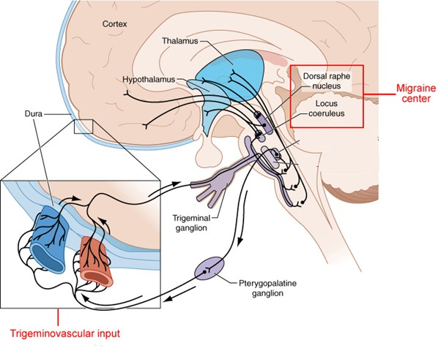
MIGRAINE PATHOPHYSIOLOGY

Slide 18
MIGRAINE PATHOPHYSIOLOGY
Trigeminovascular system as the final common pathway in Migraine
A neurovascular disorder: Changes in the modulating nociceptive input from LC/DRN results in CSD and Trigeminovascular axis activation with release of neuropeptites from presynaptic terminals: SP/CGRP, Neurokinin A, resulting in vasodilatation, neurogenic inflammation , allodynia and Migraine pain
Pain: From activation and sensitization of Trigeminal sensory afferents and neurogenically mediated sterile inflammatory Response and central sensitization (Allodynia)
Noxious cervical afferent contributes to HA in Migraine sufferers

Slide 19
TREATMENT
MIGRAINE
Avoidance of triggers: Red wine (Tannins, Phenolic flavonoids interact with 5-HT metabolism), etc.
Medications: Preventive-Abortive
Headache infusion therapy: Propofol, Ketamine, Mg, DHE
Psychological interventions
Complimentary and alternative Rx
Interventional pain management

Slide 20
PREVENTIVE TREATMENT OF MIGRAINE
Medications and Mode of action
Indications/Response rate
Antidepressants: 5-HT2 receptor antagonism
Antiepileptic medications: 5-HT2 blockade/GABA/CAI. Modulates Trigeminovascular transmission via KAINATE/AMPA receptors impacting glutamate levels
Blood pressure medications: Adrenergic /Ca channel blockade/5-HT2
Botulinum Toxin: Only for CM: SNAP-25, prevents Central/ peripheral sensitization by inhibition of release of ACH, SP, CGRP-Neurokinin-A and Ca channel blockade. Better for Imploding type Migraine headache.
Herbal, alternative medicine, Muscle relaxants

Slide 21
ABORTIVE TREATMENT
OF MIGRAINE
Medications
Antiemetics
Simple analgesics: NSAIDS (Caution: MOA)
Caffeine
Triptans-Ergot alkaloids: 5-HT1 b/d Agonist resulting in blockade of release of SP, CGRP, Neurokinin A, preventing neurogenic inflammation

Slide 22
TREATMENT
Secondary HA
Treatment of the underlying condition
Medications
Interventional pain management

Slide 23
TREATMENT
INTERVENTIONAL
MANAGEMENT

Slide 24
TREATMENT
Interventional Management
Based on recent scientific breakthroughs

Slide 25
MIGRAINE PATHOPHYSIOLOGY

Slide 26
INTERVENTIONAL PROCEDURES
Cervical epidural steroid injection
Cervical RF ablation
Cervical spinal cord stimulation
Sphenopalatine ganglion block/stim/RF ablation
Occipital/supra/infra-orbital N. block/stimulation
Gasserian ganglion block/RF ablation
Stellate ganglion block/RF ablation
Onabutulinum Toxin Injection

Slide 27
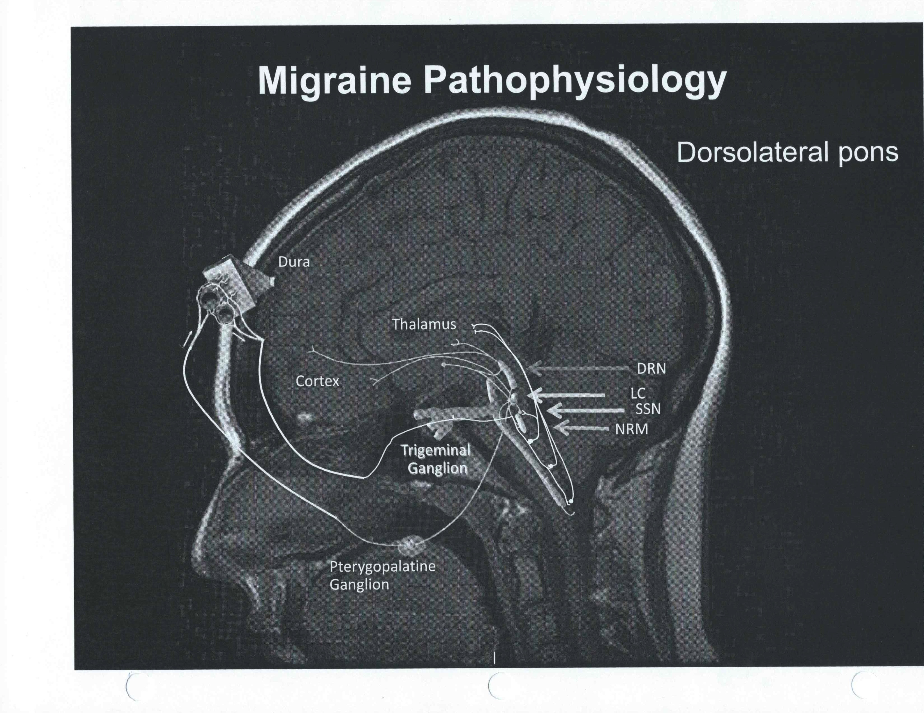
MIGRAINE PATHOPHYSIOLOGY

Slide 28
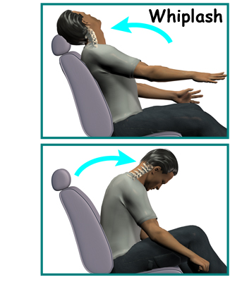
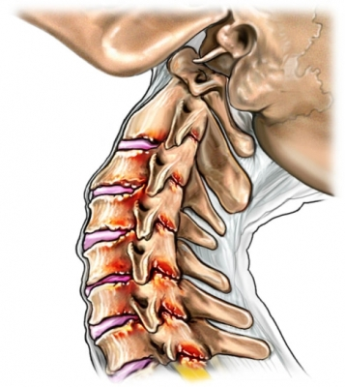
CERVICAL WHIPLASH

Slide 29
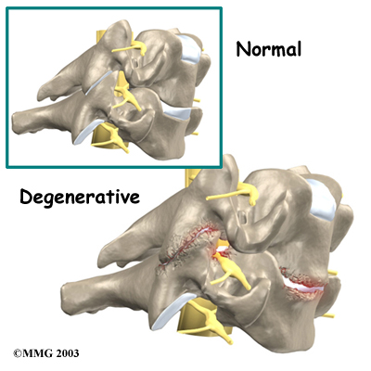
CERVICAL FACET ARTHROPATHY

Slide 30
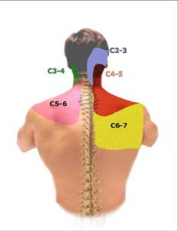
CERVICAL FACET PAIN REFERRAL PATTERN

Slide 31
CERVICAL ACCELERATION/DECELERATION SYNDROME
http://www.guardianpaininstitute.com/home/whiplash/

Slide 32
CERVICAL MEDIAL BRANCH N. RFA
http://www.guardianpaininstitute.com/?page_id=347

Slide 33
CONCLUSION
HA is one of the most prevalent maladies
Need for specialized/subspecialized approach
Proper diagnosis
Great opportunities for Rx

Slide 34
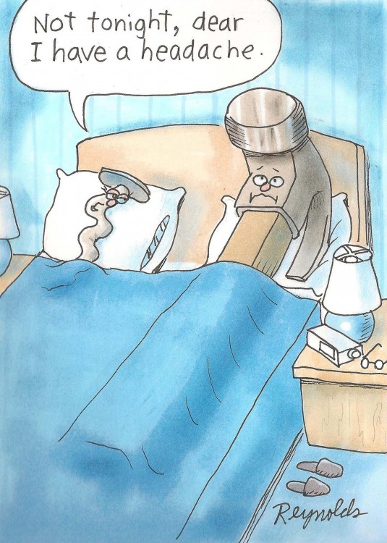
THANK YOU

Slide 35
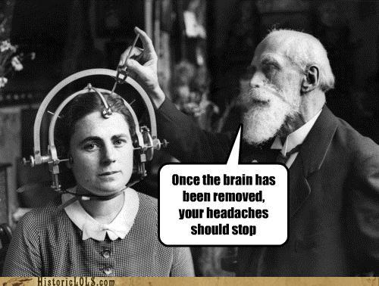
THANK YOU

